Slide 1
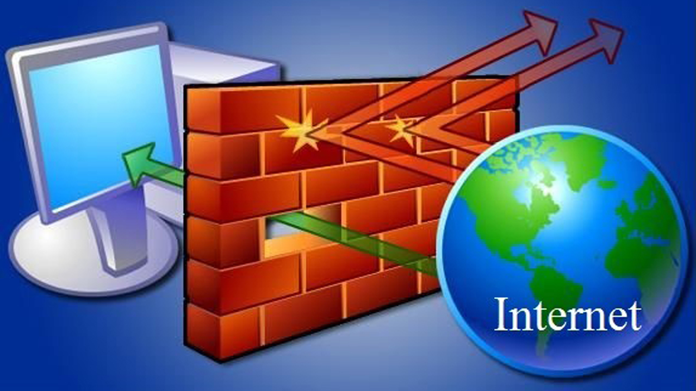
TỔNG QUAN VỀ FIREWALL
Nguyễn Văn Bình

Slide 2


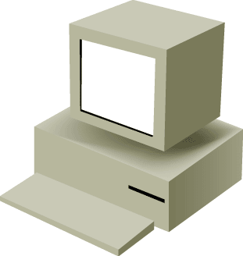


Firewall là gì?
DMZ
Network
Internet
Outside
Network
Inside
Network
A firewall is a system or group of systems that manages access between two or more networks.

Slide 3
Các kỹ thuật trong Firewall
Firewall operations are based on one of these technologies:
Packet filtering (ACL)
Stateful packet filtering (Stateful FW)
Proxy server (Web Proxy Server)
Next Generation Firewall (AV, IDS/IPS)

Slide 4
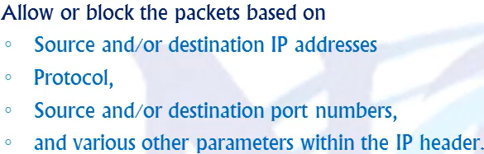
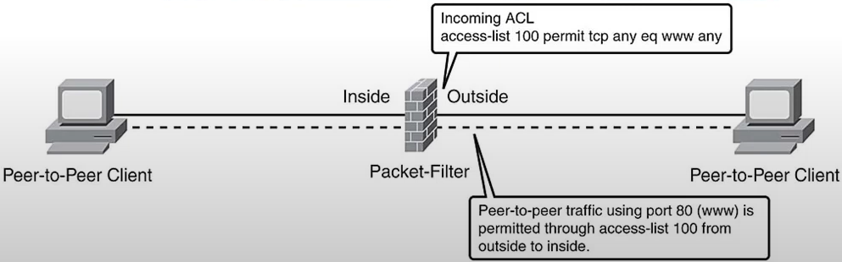
Kỹ thuật Packet Filtering
Limits information that is allowed into a network based on the destination and source address

Slide 5
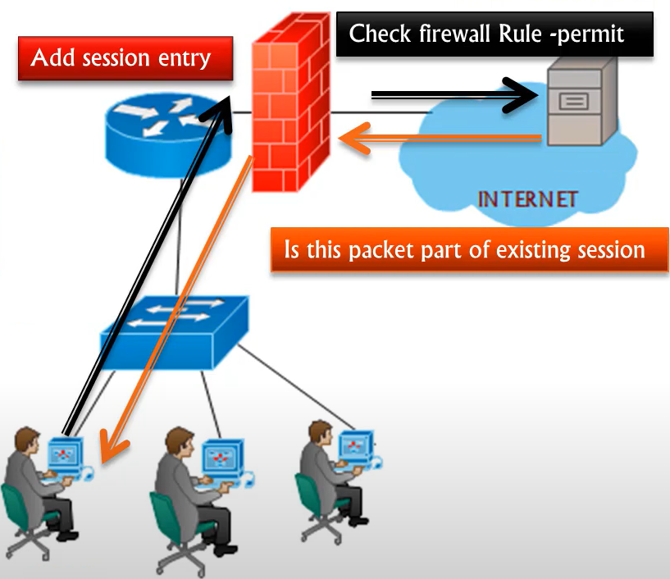
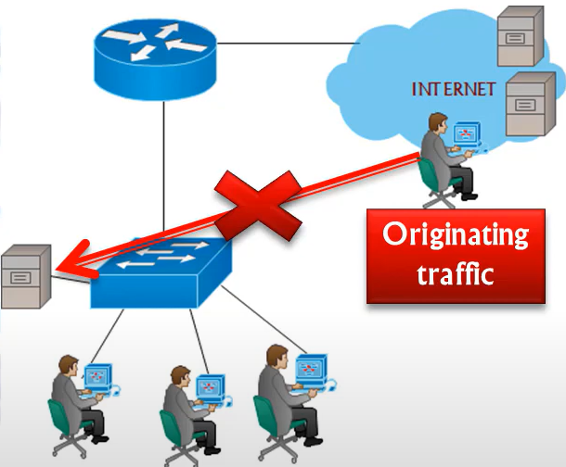
Kỹ thuật Stateful Packet Filtering
State Table
Source address
192.168.0.20
10.0.0.11
Destination address
172.16.0.50
172.16.0.50
Limits information that is allowed into a network based not only on the destination and source addresses, but also on the packets state table content
Source port
1026
1026
Destination port
80
80
Initial sequence no.
49769
49091
Ack
Flag
Syn
Syn

Slide 6
Kỹ thuật Proxy Server
Proxy
Server
Internet
Outside
Network
Inside
Network
Requests connections on behalf of a client

Slide 7
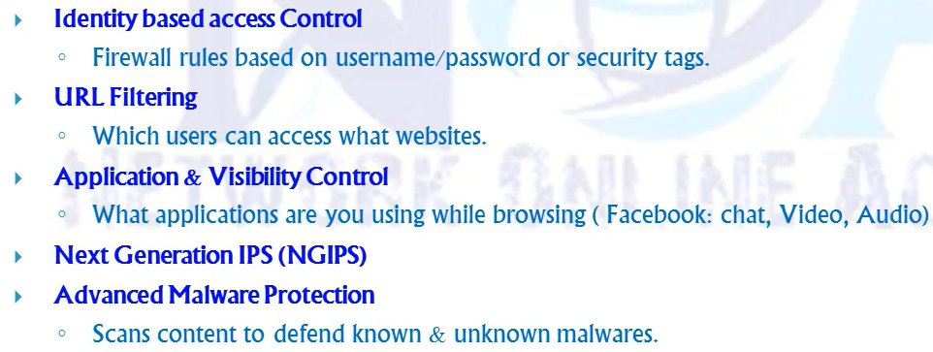
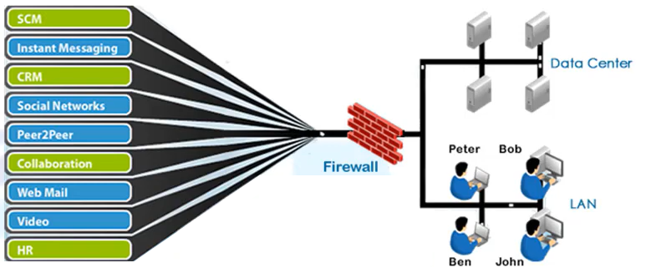
Next Generation FW

Slide 8
Các tính năng của Firewall
Some features of security appliances are:
Proprietary operating system
Stateful packet inspection
User-based authentication
Protocol and application inspection
Modular policy framework
Virtual private networking
Security contexts (virtual firewalls)
Stateful failover capabilities
Transparent firewalls
Web-based management solutions

Slide 9
Tính năng Stateful Packet Inspection
The stateful packet inspection algorithm provides stateful connection security.
It tracks source and destination ports and addresses, TCP sequence numbers, and additional TCP flags.
It randomizes the initial TCP sequence number of each new connection.
By default, the stateful packet inspection algorithm allows connections originating from hosts on inside (higher security level) interfaces.
By default, the stateful packet inspection algorithm drops connection attempts originating from hosts on outside (lower security level) interfaces.
The stateful packet inspection algorithm supports authentication, authorization, and accounting.

Slide 10

Tính năng Application-Aware Inspection
FTP
Server
Client
Data
Port 20
Control
Port
21
Control
Port
2008
Data
Port
2010
Data - Port 2010
Port 2010 OK
Data
Protocols such as FTP, HTTP, H.323, and SQL*Net need to negotiate connections to dynamically assigned source or destination ports through the firewall.
The security appliance inspects packets above the network layer.
The security appliance securely opens and closes negotiated ports for legitimate client-server connections through the firewall.

Slide 11





Tính năng Modular Policy
System Engineer
Internet
Headquarters
T1
SE
Executives
exec
Internet
S2S
S2S
Site C
Site B
Class Map
Traffic Flow
Default
Internet
Systems Engineer
Executives
Site to Site
Policy Map
Services
Inspect
IPS
Police
Priority
Service Policy
Interface/Global
Global
Outside

Slide 12



Tính năng Virtual Private Network
B A N K
B A N K
Site to Site
Internet
IPsec VPN
SSL VPN
Headquarters
Remote Access

Slide 13
Tính năng Security Context (Virtual Firewall)
Four Physical Firewalls
One Physical Firewall
Four Virtual Firewalls
Internet
Internet
Ability to create multiple security contexts (virtual firewalls) within a single security appliance

Slide 14




Tính năng Failover
Failover: Active/Standby
Failover: Active/Active
Contexts
1
2
1
2
Primary:
Failed Firewall
Secondary:
Active Firewall
Primary:
Failed/Standby
Secondary:
Active/Active
Internet
Internet
Failover protects the network if the primary security appliance goes offline..
Active/standby: Only one unit can be actively processing traffic; the other is hot standby.
Active/Active: Both units can process traffic and serve as backup units.
Stateful failover maintains the operating state during failover.

Slide 15
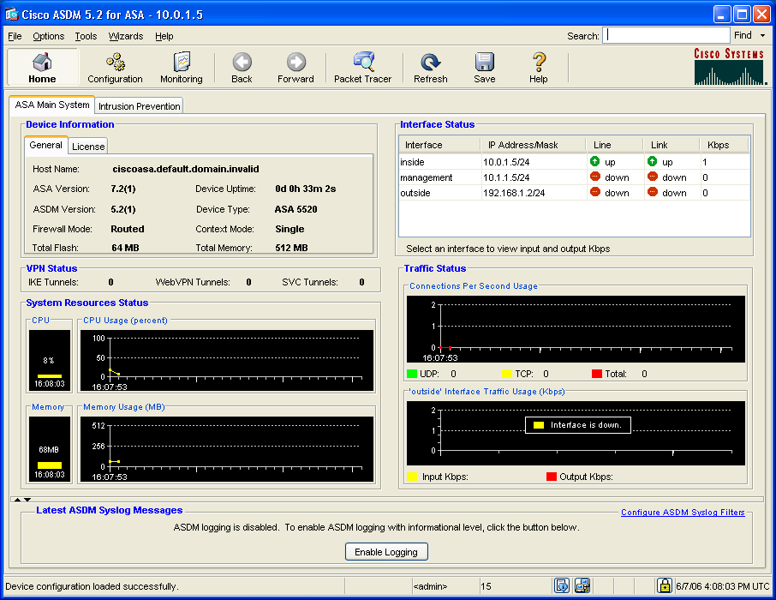
Tính năng Web-Based Management
Adaptive
Security
Device
Manager

Slide 16

Thảo luận

